Slide 1
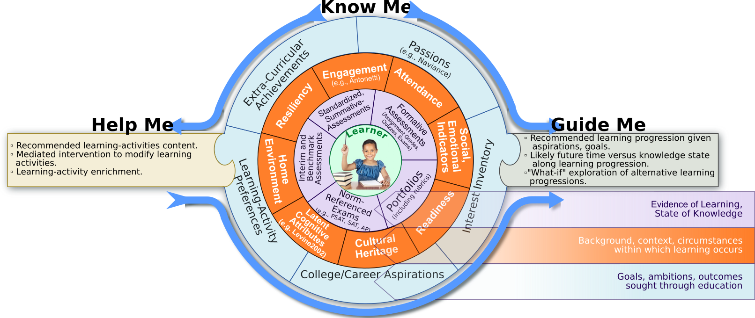
Watson Classroom’s original vision sought to realize support the personalization of learning through a 360º view of each individual student.

Slide 2
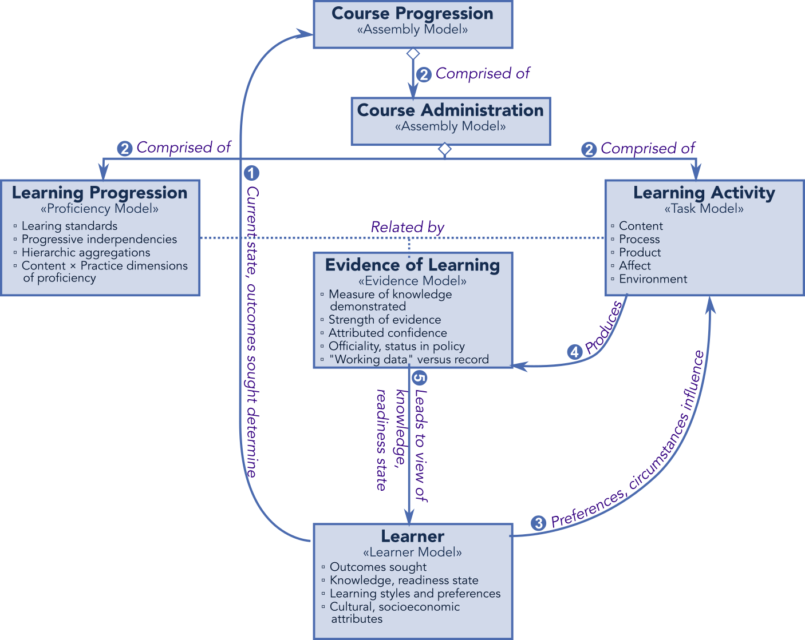
Watson Mastery’s “Evidence of Learning, State of Knowledge” view of the learner is realized through a general cognitive diagnostic framework called “Evidence-Centered Design” (ECD).

Slide 3
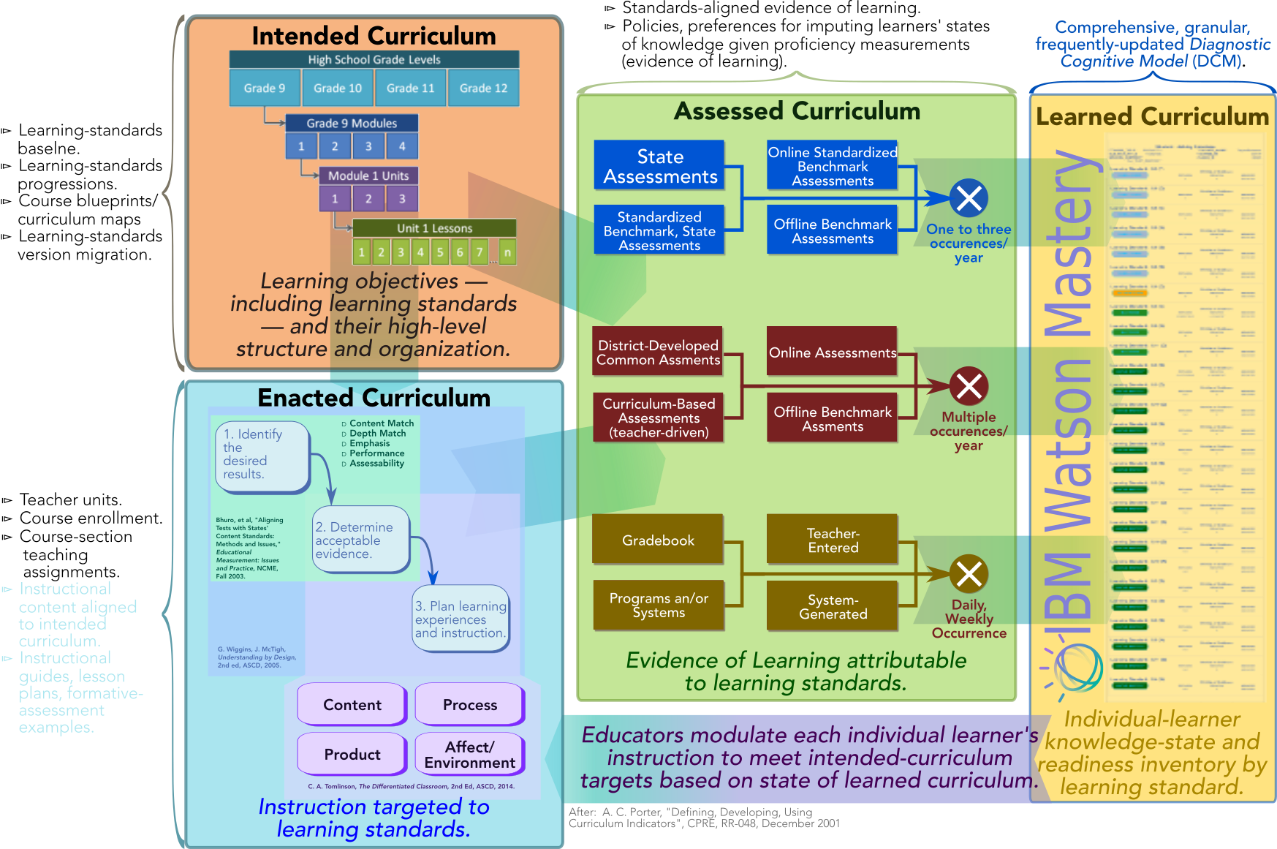
Operationalizing ECD in the classroom, Watson-Education Mastery provides management of competency-based personalized learning through a digitized, aligned curriculum.

Slide 4
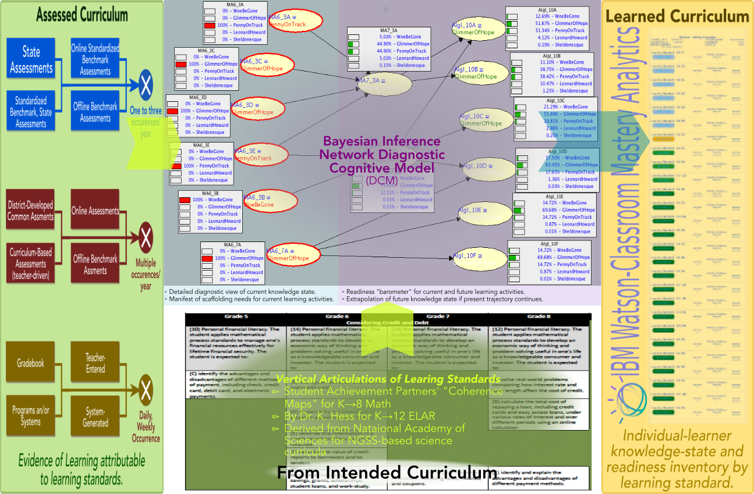
The Diagnostic Cognitive Model (DCM) underlying Watson Mastery relates individual students’ evidence of learning to their state of knowledge using proficiency model based on educational learning standards (e.g., Common Core).

Slide 5
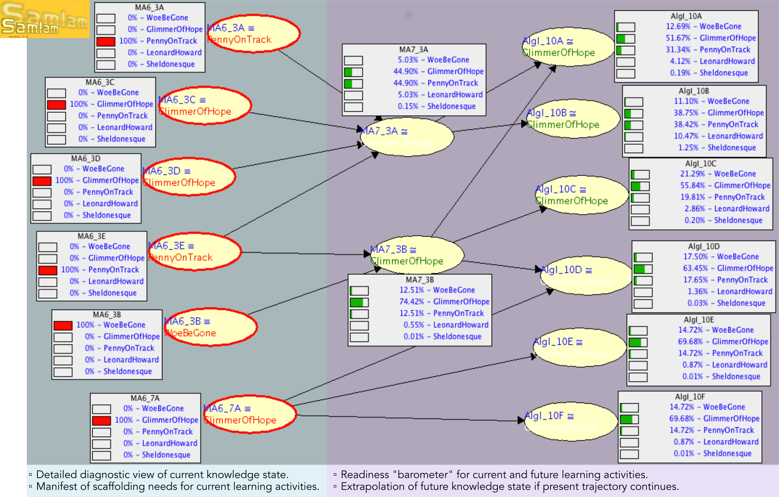
Watson Mastery realizes its DCM using a Bayesian-Network algorithm, which relates observed proficiencies to diagnoses of readiness to engage instructional content on which the priors are dependent.

